Slide 1
Illustration
Ki Hyun Kim

Slide 2
z
x+y
…
x
y

Slide 3
Related meaning
Sense 1
Sense 2
Word 2
Sense 3
Word 1
Sense 4
Sense 5
Related meaning

Slide 4
entity .n.01
physical_entity .n.01
causal_agent .n.01
person .n.01
worker .n.01
employee .n.01
deliveryman .n.01
mailman .n.01
enrollee .n.01
preserver .n.03
defender .n.01
lawman .n.01
sheriff .n.01
fireman .n.04
policeman .n.01
student .n.01

Slide 5
GREEN | L1 Norm
BLUE | L2 Norm
RED | Infinity Norm

Slide 7
(0,1,0)
(0,1,0)
(0,0,1)
(0,0,1)
0
(1,0,0)
0
(1,0,0)

Slide 8
검은점과 검은 선 사이 거리의 합이 최소가 되도록
빨간점 사이의 거리의 합이 최대가 되도록

Slide 12
Encoder
(Dimension Reduction)
Decoder
(Reconstruction)

Slide 13
Manifold?

Slide 15
Reconstruction
Error:
MSE Loss

Slide 16
|V|
Embedding
Vector Size
Embedding
Vector Size
Embedding Layer Weight
Embedding Vector
One-hot Vector

Slide 17
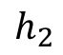
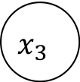
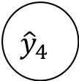
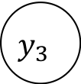
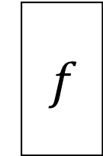
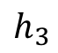

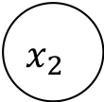
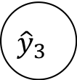
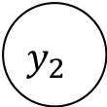
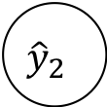
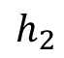
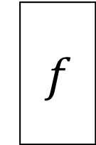
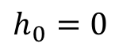

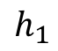
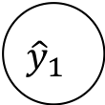
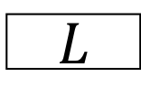
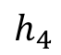
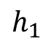
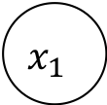
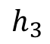
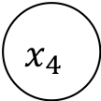
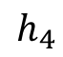
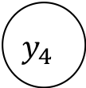
$$y_{1}$$
$$y_{2}$$
$$y_{3}$$
$$y_{4}$$
$$L$$
$${\hat{y}}_{1}$$
$${\hat{y}}_{2}$$
$${\hat{y}}_{3}$$
$${\hat{y}}_{4}$$
$$h_{1}$$
$$h_{2}$$
$$h_{3}$$
$$h_{4}$$
$$f$$
$$f$$
$$f$$
$$f$$
$$h_{0}=0$$
$$h_{1}$$
$$h_{2}$$
$$h_{3}$$
$$h_{4}$$
$$x_{1}$$
$$x_{2}$$
$$x_{3}$$
$$x_{4}$$

Slide 18
$$y_{1}$$
$$y_{2}$$
$$y_{3}$$
$$y_{4}$$
$$L$$
$${\hat{y}}_{1}$$
$${\hat{y}}_{2}$$
$${\hat{y}}_{3}$$
$${\hat{y}}_{4}$$
$$h_{1}$$
$$h_{2}$$
$$h_{3}$$
$$h_{4}$$
$$f$$
$$f$$
$$f$$
$$f$$
$$h_{0}=0$$
$$h_{1}$$
$$h_{2}$$
$$h_{3}$$
$$h_{4}$$
$$x_{1}$$
$$x_{2}$$
$$x_{3}$$
$$x_{4}$$

Slide 19
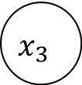
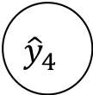
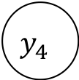
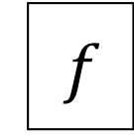
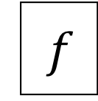


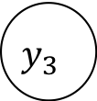
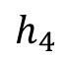

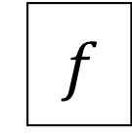


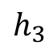
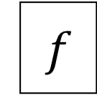

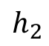
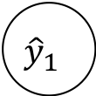



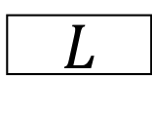
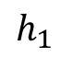
$$y_{1}$$
$$y_{2}$$
$$y_{3}$$
$$y_{4}$$
$$L$$
$${\hat{y}}_{1}$$
$${\hat{y}}_{2}$$
$${\hat{y}}_{3}$$
$${\hat{y}}_{4}$$
$$h_{1}$$
$$h_{2}$$
$$h_{3}$$
$$h_{4}$$
$$f$$
$$f$$
$$f$$
$$f$$
$$f$$
$$f$$
$$f$$
$$f$$
$$f$$
$$f$$
$$f$$
$$f$$
$$x_{1}$$
$$x_{2}$$
$$x_{3}$$
$$x_{4}$$

Slide 20
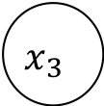





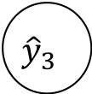
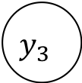
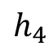





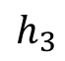


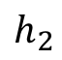



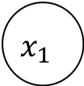
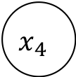
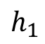

$$y_{1}$$
$$y_{2}$$
$$y_{3}$$
$$y_{4}$$
$$L$$
$${\hat{y}}_{1}$$
$${\hat{y}}_{2}$$
$${\hat{y}}_{3}$$
$${\hat{y}}_{4}$$
$$h_{1}$$
$$f$$
$$h_{2}$$
$$f$$
$$h_{3}$$
$$f$$
$$h_{4}$$
$$f$$
$$f$$
$$f$$
$$f$$
$$f$$
$$f$$
$$f$$
$$f$$
$$f$$
$$f$$
$$f$$
$$f$$
$$f$$
$$f$$
$$f$$
$$f$$
$$f$$
$$f$$
$$f$$
$$f$$
$$f$$
$$x_{1}$$
$$x_{2}$$
$$x_{3}$$
$$x_{4}$$

Slide 21

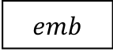

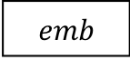

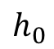
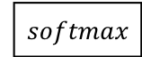

매우 긍정
…1000…
$$L$$
긍정
…
0.1
0.7
0.2
0.1
…
$$softmax$$
$$h_{1}$$
$$h_{2}$$
$$h_{3}$$
$$h_{4}$$
$$f$$
$$f$$
$$f$$
$$f$$
$$h_{0}$$
$$h_{1}$$
$$h_{2}$$
$$h_{3}$$
$$h_{4}$$
$$emb$$
$$emb$$
$$emb$$
$$emb$$
…0010…
BOS
$$나는$$
$$학교에$$
$$가는$$

Slide 22











$$너는$$
$$직장에$$
$$가는$$
$$것을$$
…1000…
$$L$$
$$나는$$
$$학교에$$
$$가는$$
$$것을$$
…
0.1
0.7
0.2
0.1
…
$$softmax$$
$$softmax$$
$$softmax$$
$$softmax$$
$$h_{1}$$
$$h_{2}$$
$$h_{3}$$
$$h_{4}$$
$$f$$
$$f$$
$$f$$
$$f$$
$$h_{0}$$
$$h_{1}$$
$$h_{2}$$
$$h_{3}$$
$$h_{4}$$
$$emb$$
$$emb$$
$$emb$$
$$emb$$
…0010…
BOS
$$나는$$
$$학교에$$
$$가는$$

Slide 23














$$c_{t−1}$$
x
+
$$c_{t}$$
$$forget(σ)$$
$$f_{t}$$
$$tanh$$
$$h_{t−1}$$
$$output(σ)$$
$$o_{t}$$
x
$$h_{t}$$
$$tanh$$
$$g_{t}$$
x
$$input(σ)$$
$$i_{t}$$
$$x_{t}$$

Slide 24







x
$$reset(σ)$$
$$r_{t}$$
$$h_{t−1}$$
x
+
$$h_{t}$$
$$tanh$$
$$n_{t}$$
$$update(σ)$$
$$z_{t}$$
x
$$x_{t}$$

Slide 25



$$x_{1,1}$$ | $$x_{1,2}$$ | $$x_{1,3}$$
$$x_{2,1}$$ | $$x_{2,2}$$ | $$x_{2,3}$$
$$x_{3,1}$$ | $$x_{3,2}$$ | $$x_{3,3}$$
$$k_{1,1}$$ | $$k_{1,2}$$ | $$k_{1,3}$$
$$k_{2,1}$$ | $$k_{2,2}$$ | $$k_{2,3}$$
$$k_{3,1}$$ | $$k_{3,2}$$ | $$k_{3,3}$$
$$y_{1,1}$$

Slide 26











Embedding Vector Size
#filters
$$x_{1,1}$$ | $$x_{1,2}$$ | $$x_{1,3}$$ | $$x_{1,4}$$ | $$x_{1,5}$$ | $$x_{1,6}$$
$$y_{1,1}$$
$$y_{1,1}$$
$$y_{1,1}$$
$$y_{1,1}$$
#filters
$$k_{1,1}$$ | $$k_{1,2}$$ | $$k_{1,3}$$ | $$k_{1,3}$$ | $$k_{1,3}$$ | $$k_{1,3}$$
Batch Size
$$⨂$$
$$k_{1,1}$$ | $$k_{1,2}$$ | $$k_{1,3}$$ | $$k_{1,3}$$ | $$k_{1,3}$$ | $$k_{1,3}$$
$$=$$
$$k_{1,1}$$ | $$k_{1,2}$$ | $$k_{1,3}$$ | $$k_{1,3}$$ | $$k_{1,3}$$ | $$k_{1,3}$$
$$k_{1,1}$$ | $$k_{1,2}$$ | $$k_{1,3}$$ | $$k_{1,4}$$ | $$k_{1,5}$$ | $$k_{1,6}$$
Embedding Vector Size

Slide 27










$${\hat{x}}_{1}$$
$${\hat{x}}_{2}$$
$${\hat{x}}_{3}$$
$${\hat{x}}_{4}$$
$${\hat{x}}_{5}$$
softmax
softmax
softmax
softmax
softmax
rnn cell
rnn cell
rnn cell
rnn cell
rnn cell
rnn cell
rnn cell
rnn cell
rnn cell
rnn cell
embedding
embedding
embedding
embedding
embedding
$$x_{0}$$
$$x_{1}$$
$$x_{2}$$
$$x_{3}$$
$$x_{4}$$

Slide 28












Generator
$${\hat{y}}_{1}$$
$${\hat{y}}_{2}$$
$${\hat{y}}_{3}$$
$$EOS$$
softmax
softmax
softmax
softmax
Encoder
Decoder
Stacked RNN Cells
Stacked RNN Cells
Stacked RNN Cells
Stacked RNN Cells
Stacked RNN Cells
Stacked RNN Cells
Stacked RNN Cells
Stacked RNN Cells
Embedding
Embedding
Embedding
Embedding
Embedding
Embedding
Embedding
Embedding
$$x_{1}$$
$$x_{2}$$
$$x_{3}$$
$$x_{4}$$
$$BOS$$
$$y_{1}$$
$$y_{2}$$
$$y_{3}$$

Slide 29










$${\hat{y}}_{1}$$
$${\hat{y}}_{2}$$
$${\hat{y}}_{3}$$
Context vector
softmax
softmax
softmax
Attention weight
concat
concat
concat
Concatenated Encoder Output
W
Stacked RNN Cells
Stacked RNN Cells
Stacked RNN Cells
Stacked RNN Cells
Stacked RNN Cells
Stacked RNN Cells
Stacked RNN Cells
● ● ●
Embedding
Embedding
Embedding
Embedding
Embedding
Embedding
Embedding
$$x_{1}$$
$$x_{2}$$
$$x_{3}$$
$$x_{4}$$
$$BOS$$
$$y_{1}$$
$$y_{2}$$

Slide 30
$${\hat{y}}_{1}$$
$${\hat{y}}_{2}$$
$${\hat{y}}_{3}$$
Context vector
softmax
softmax
softmax
Attention weight
concat
concat
concat
Concatenated Encoder Output
W
Stacked RNN Cells
Stacked RNN Cells
Stacked RNN Cells
Stacked RNN Cells
Stacked RNN Cells
Stacked RNN Cells
Stacked RNN Cells
● ● ●
;
;
Embedding
Embedding
Embedding
Embedding
Embedding
Embedding
Embedding
$$x_{1}$$
$$x_{2}$$
$$x_{3}$$
$$x_{4}$$
$$BOS$$
$$y_{1}$$
$$y_{2}$$

Slide 31
학교에
Context
Vector
Linear Transform
0.2
0.8
I | love | to | go | to | school | .
나는
학교에

Slide 32
school
school
school
school
school
school
school
school
I
I
I
I
I
I
I
I
love
love
love
love
love
love
love
love
you
you
you
you
you
you
you
you
BOS
to
to
to
to
to
to
to
to
go
go
go
go
go
go
go
go
eat
eat
eat
eat
eat
eat
eat
eat
EOS
EOS
EOS
EOS
EOS
EOS
EOS
EOS

Slide 33
I | …
<EOS> | …
school | …
go | .3
love | .2
you | …
. | …
to | …
I | …
<EOS> | …
school | …
go | …
love | …
you | …
. | …
to | …
I | …
<EOS> | …
school | .3
go | .4
love | …
you | …
. | …
to | …
I | …
<EOS> | …
school | .2
go | …
love | …
you | …
. | .1
to | .6
I | …
<EOS> | …
school | .2
go | …
love | …
you | …
. | …
to | …
I | …
<EOS> | …
school | …
go | …
love | …
you | …
. | .4
to | …
I | .4
<EOS> | …
school | …
go | .3
love | …
you | .2
. | …
to | …
I | …
<EOS> | …
school | …
go | …
love | .3
you | …
. | …
to | …
I | …
<EOS> | …
school | .2
go | .2
love | …
you | …
. | …
to | .5
I | …
<EOS> | …
school | …
go | …
love | …
you | …
. | …
to | …
I | …
<EOS> | …
school | …
go | …
love | …
you | …
. | …
to | …
I | …
<EOS> | …
school | …
go | …
love | …
you | …
. | .5
to | …
I | …
<EOS> | .6
school | …
go | …
love | …
you | …
. | …
to | …
<BOS>
I | …
<EOS> | …
school | …
go | …
love | …
you | …
. | …
to | …
I | …
<EOS> | …
school | …
go | …
love | …
you | …
. | …
to | …
I | …
<EOS> | …
school | .8
go | …
love | …
you | …
. | …
to | …
I | …
<EOS> | …
school | …
go | …
love | …
you | …
. | …
to | …
I | …
<EOS>
school | …
go | …
love | …
you | …
. | …
to | …
I
<EOS>
school
go
love
you
.
to

Slide 34



$$\frac{Hidden Size}{2}$$
Backward
Forward
Hidden Size
Layer 3
Forward Backward
#layers $×$ #directions
$$=3×2$$
Layer 2
Layer 3
#layers $=3$
Layer 2
Layer 1
Layer 1
Batch Size
Batch Size

Slide 35

Batch Size
or
# Samples
Time-Step
Beam Size

Slide 36

1-word
Word Vector Dim
Beam Size
Beam Size
$$×$$
# Samples
Get Batch
Time-Step
Beam Size
Sequence-to-Sequence
Batch Size
or
# Samples
Translated Fabricated Mini-batch
Separation
and
Collecting

Slide 37
Linear

Slide 38

I love to go to school.

Slide 39




$$σ$$
$$2d$$
$$k$$
$$d$$

Slide 40
0.1
State
C
0.3
0.3
0.2
0.6
0.6
State
A
State
B
0.2
0.3
0.4

Slide 41













$$0.4|x$$
State
C
$$0.4|x$$
$$0.1|y$$
$$0.1|x$$
$$0.2|x$$
$$0.1|x$$
$$0.3|y$$
State
A
State
B
$$0.8|x$$
$$0.7|y$$
$$0.5|x$$
$$0.3|y$$
$$0.5|x$$
$$0.6|y$$

